Slide 1
Computer Architecture Simulators for Different Instruction Formats
Xuejun Liang
Department of Computer Science
California State University – Stanislaus
Turlock, CA 95382, USA

Slide 2
Motivation
MARIE is an accumulator-based machine simulator
  Used in The Essentials of Computer Organization and Architecture, by Linda Null and Julia Lobur for assembly language programming
But, MARIE simulator has some problems:
  Programmers can not define a variable to hold the address of another variable symbolically.
  Conditional branch can only skip the next instruction. It takes numbers as its operands for indicating different conditions. Programmers have to remember these numbers.
  MARIE do not have the stack pointer. So there is no stack frame and its subroutine has no local variables and can not be recursive.
How to solve these problems?
  Fix it or create a new one.

Slide 3
Purpose
To solve these problems, and furthermore, to be able to compare different computer architectures, a set of computer simulators for different instruction formats are developed.
Using these simulators
  Program different computer processors using assembly languages.
Modifying these simulators
  Add more instructions
  Add more debugging functions
  Add user interfaces
  Design microarchitectures to support the execution of instructions of simulated machines
Serving as compiler’s target computers

Slide 4
Outlines
Simulated Instruction Sets
  Stack-based (Zero address) Machine
  Accumulator-based (one address) Machine
  Two address Machine
    Memory-to-Memory and Register-to-Register
  Three address Machine
    Memory-to-Memory and Register-to-Register
Assembly Language Programming Examples
  Compute sum of absolute values of elements in an array
  Compute Fibonacci numbers
    Using loop, function, and recursive function

Slide 5
Two-address machine (M-to-M)
Binary, two's complement data representation.
Stored program, fixed word length data and instructions.
64K words of word-addressable data memory.
64K double words of word-addressable instruction memory.
32-bit data words.
64-bit instructions.
A 32-bit arithmetic logic unit (ALU).
  Only arithmetic operations are implemented
Registers
  PC: 32-bit Program counter
  SP: Stack pointer pointing to the top of the stack

Slide 6
Implementations (1)
Two separate 32-bit integer arrays are used for memory data, and input data, respectively.
One 64-bit integer arrays are used for instructions.
But, Each instruction takes only 39 bits
  5-bit opcode, and two 16-bit operand (address).
  Two 1-bit indicating if the operand is local or global.
Instruction memory address is 16 bits. So, Instructions will take up to 64K 64-bit words (or integers).
The branch instructions use 16-bit absolute address. The instructions JNS also uses 16-bit absolution address
Each datum occupies 32 bits. The data address is 16 bits. So, we have 64K words of data memory.
Stack is growing towards higher data memory address

Slide 7
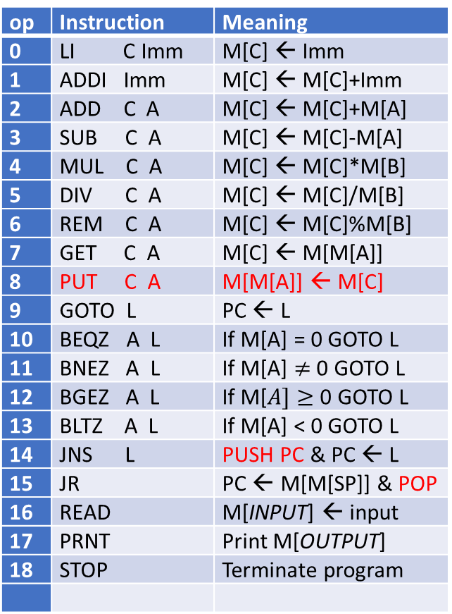
Instruction Set
Two M2M
op | Instruction | Meaning
0 | LI C Imm | M[C] ← Imm
1 | ADDI Imm | M[C] ← M[C]+Imm
2 | ADD C A | M[C] ← M[C]+M[A]
3 | SUB C A | M[C] ← M[C]-M[A]
4 | MUL C A | M[C] ← M[C]*M[B]
5 | DIV C A | M[C] ← M[C]/M[B]
6 | REM C A | M[C] ← M[C]%M[B]
7 | GET C A | M[C] ← M[M[A]]
8 | PUT C A | M[M[A]] ← M[C]
9 | GOTO L | PC ← L
10 | BEQZ A L | If M[A] = 0 GOTO L
11 | BNEZ A L | If M[A] $≠$ 0 GOTO L
12 | BGEZ A L | If M[$A]≥$ 0 GOTO L
13 | BLTZ A L | If M[A] < 0 GOTO L
14 | JNS L | PUSH PC & PC ← L
15 | JR | PC ← M[M[SP]] & POP
16 | READ | M[INPUT] ← input
17 | PRNT | Print M[OUTPUT]
18 | STOP | Terminate program
Imm: 16-bit 2’s compliment
PC: Program counter
M[A]: Memory content of variable A
PUSH PC: Push PC on stack
POP: Remove top content on stack
SP: Reserved location, Stack pointer
ZERO: Reserved location, M[ZERO]=0
INPUT: Reserved location for input
OUTPUT: Reserved location for output
$+Imm: Local variable
Its address is M[SP]+Imm, where Imm is a 16-bit integer.
Example: ADD Var $+4 means
M[Var] = M[Var] + M[M[SP]+4]

Slide 8
Pseudo-Instructions
 | Pseudo-instruction | Meaning | Instruction
1 | MOVE A B | M[A] ← M[B] | ADD ZERO B LI A 0 ADD A ZERO LI ZERO 0
2 | NEG A | M[A] ←-M[A] | SUB ZERO A LI A 0 ADD A ZERO LI ZERO 0
3 | POP A | M[A] ← M[M[SP]] M[SP] ← M[SP] – 1 | GET A SP ADDI SP -1
4 | PUSH A | M[SP] ← M[SP] + 1 M[M[SP]] ← M[A] | ADDI SP 1 PUT A SP

Slide 9
Three-address machine (M-to-M)
Binary, two's complement data representation.
Stored program, fixed word length data and instructions.
64K words of word-addressable data memory.
64K double words of word-addressable instruction memory.
32-bit data words.
64-bit instructions.
A 32-bit arithmetic logic unit (ALU).
  Only arithmetic operations are implemented
Registers
  PC: 32-bit Program counter
  SP: Stack pointer pointing to the top of the stack

Slide 10
Implementations (1)
Two separate 32-bit integer arrays are used for memory data, and input data, respectively.
One 64-bit integer arrays are used for instructions.
But, Each instruction takes only 56 bits
  5-bit opcode, and three 16-bit operand (address).
  Three 1-bit indicating if the operand is local or global.
Instruction memory address is 16 bits. So, Instructions will take up to 64K 64-bit words (or integers).
The branch instructions use 16-bit absolute address. The instructions JNS also uses 16-bit absolution address
Each datum occupies 32 bits. The data address is 16 bits. So, we have 64K words of data memory.
Stack is growing towards higher data memory address

Slide 11
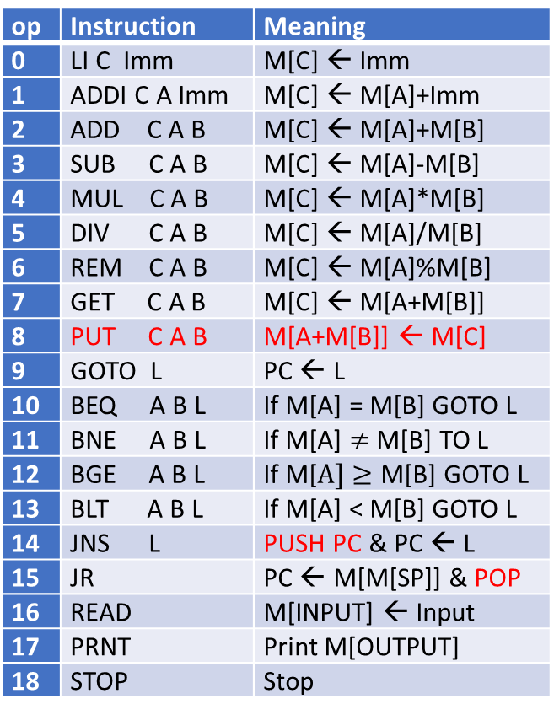
Instruction Set
Three M2M
op | Instruction | Meaning
0 | LI C Imm | M[C] ← Imm
1 | ADDI C A Imm | M[C] ← M[A]+Imm
2 | ADD C A B | M[C] ← M[A]+M[B]
3 | SUB C A B | M[C] ← M[A]-M[B]
4 | MUL C A B | M[C] ← M[A]*M[B]
5 | DIV C A B | M[C] ← M[A]/M[B]
6 | REM C A B | M[C] ← M[A]%M[B]
7 | GET C A B | M[C] ← M[A+M[B]]
8 | PUT C A B | M[A+M[B]] ← M[C]
9 | GOTO L | PC ← L
10 | BEQ A B L | If M[A] = M[B] GOTO L
11 | BNE A B L | If M[A] $≠$ M[B] TO L
12 | BGE A B L | If M[$A]≥$ M[B] GOTO L
13 | BLT A B L | If M[A] < M[B] GOTO L
14 | JNS L | PUSH PC & PC ← L
15 | JR | PC ← M[M[SP]] & POP
16 | READ | M[INPUT] ← Input
17 | PRNT | Print M[OUTPUT]
18 | STOP | Stop
Imm: 32-bit 2’s compliment
PC: Program counter
M[A]: Memory content of variable A
PUSH PC: Push PC on stack
POP: Remove top content on stack
SP: Reserved location, Stack pointer
ZERO: Reserved location, M[ZERO]=0
INPUT: Reserved location for input
OUTPUT: Reserved location for output
$+Imm: Local variable
Its address is M[SP]+Imm, where Imm is a 16-bit integer.
Example: ADD A B $+4 means
M[A] = M[B] + M[M[SP]+4]

Slide 12
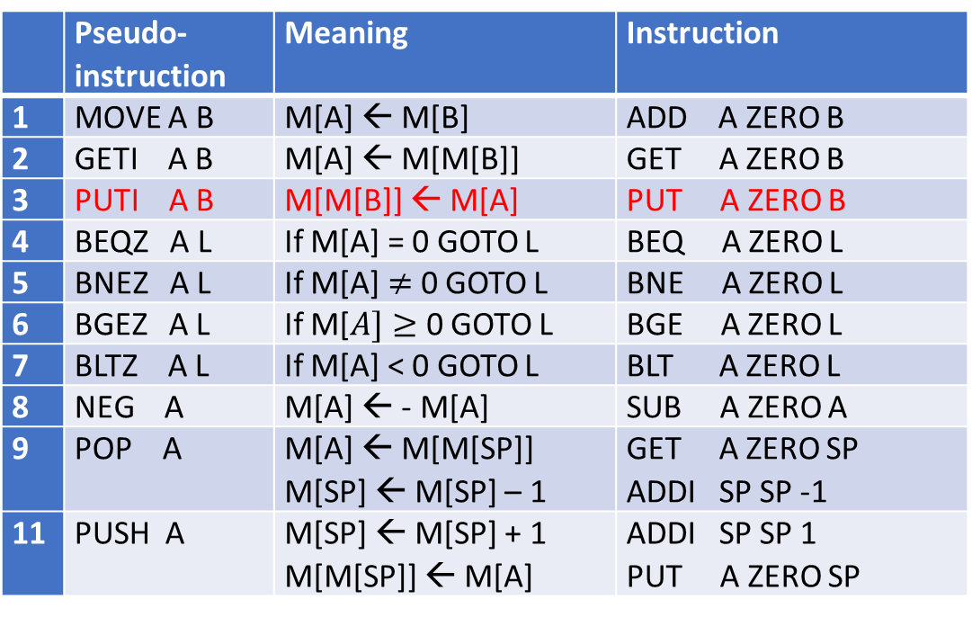
Pseudo-Instructions
 | Pseudo-instruction | Meaning | Instruction
1 | MOVE A B | M[A] ← M[B] | ADD A ZERO B
2 | GETI A B | M[A] ← M[M[B]] | GET A ZERO B
3 | PUTI A B | M[M[B]] ← M[A] | PUT A ZERO B
4 | BEQZ A L | If M[A] = 0 GOTO L | BEQ A ZERO L
5 | BNEZ A L | If M[A] $≠$ 0 GOTO L | BNE A ZERO L
6 | BGEZ A L | If M[$A]≥$ 0 GOTO L | BGE A ZERO L
7 | BLTZ A L | If M[A] < 0 GOTO L | BLT A ZERO L
8 | NEG A | M[A] ← - M[A] | SUB A ZERO A
9 | POP A | M[A] ← M[M[SP]] M[SP] ← M[SP] – 1 | GET A ZERO SP ADDI SP SP -1
11 | PUSH A | M[SP] ← M[SP] + 1 M[M[SP]] ← M[A] | ADDI SP SP 1 PUT A ZERO SP

Slide 13
Two-address machine (R-to-R)
Binary, two's complement data representation.
Stored program, fixed word length data and instructions.
64K words of word-addressable data memory.
64K words of word-addressable instruction memory.
32-bit data words.
32-bit instructions.
A 32-bit arithmetic logic unit (ALU).
  Only arithmetic operations are implemented
Registers
  PC: 32-bit Program counter
  SP: Stack pointer pointing to the top of the stack

Slide 14
32 General-Purpose Registers
MIPS Register Convention
Name | Number | Usage
$zero | $0 | The constant value 0
$at | $1 | Reserved for assembler
$v0-$v1 | $2-$3 | Expression evaluation and results of a function
$a0-$a3 | $4-$7 | Argument 1-4
$t0-$t7 | $8-$15 | Temporary (not preserved across call)
$s0-$s7 | $16-$23 | Saved temporary (preserved across call)
$t8-$t9 | $24-$25 | Temporary (not preserved across call)
$k0-$k1 | $26-$27 | Reserved for OS kernel
$gp | $28 | Pointer to global area
$sp | $29 | Stack pointer
$fp | $30 | Frame pointer
$ra | $31 | Return address (used by function call)

Slide 15
Implementations (R2R)
Three separate 32-bit integer arrays are used for instructions, memory data, and input data, respectively.
But, Each instruction takes only 26 bits
  5-bit opcode, 5-bit registers, and 16-bit operand (address).
Instruction memory address is 16 bits. So, Instructions will take up to 64K 32-bit words (or integers).
The branch instructions use 16-bit absolute address. The instructions JNS also uses 16-bit absolution address
Each datum occupies 32 bits. The data address is 16 bits. So, we have 64K words of data memory.
Stack is growing towards higher data memory address

Slide 16
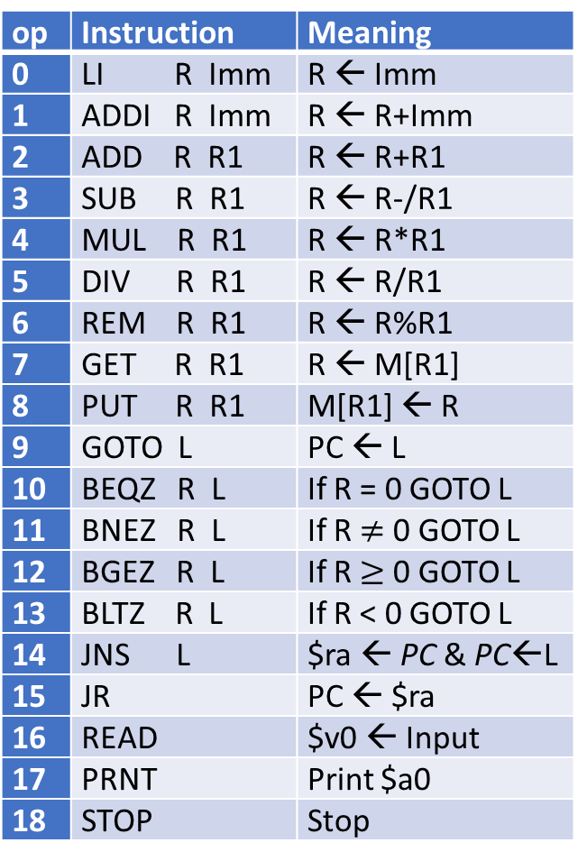
Instruction Set
Two R2R
op | Instruction | Meaning
0 | LI R Imm | R ← Imm
1 | ADDI R Imm | R ← R+Imm
2 | ADD R R1 | R ← R+R1
3 | SUB R R1 | R ← R-/R1
4 | MUL R R1 | R ← R*R1
5 | DIV R R1 | R ← R/R1
6 | REM R R1 | R ← R%R1
7 | GET R R1 | R ← M[R1]
8 | PUT R R1 | M[R1] ← R
9 | GOTO L | PC ← L
10 | BEQZ R L | If R = 0 GOTO L
11 | BNEZ R L | If R $≠$ 0 GOTO L
12 | BGEZ R L | If R $≥$ 0 GOTO L
13 | BLTZ R L | If R < 0 GOTO L
14 | JNS L | $ra ← PC & PC←L
15 | JR | PC ← $ra
16 | READ | $v0 ← Input
17 | PRNT | Print $a0
18 | STOP | Stop
Imm: 16-bit 2’s compliment
PC: Program counter
R, R1: Registers
L: Label
M[R]: Memory content at address R

Slide 17
Pseudo-Instructions
 | Pseudo-instruction | Meaning | Instruction
1 | LA R Var | R ← &Var | LI R Var
2 | MOVE R R1 | R ← R1 | LI $at 0 ADD $at R1 LI R 0 ADD R $at
3 | NEG R | R ← -R | LI $at 0 SUB $at R LI R 0 ADD R $at
4 | GETI R2 Imm | R2 ← M[Imm] | LI $at Imm GET R2 $at
5 | PUTI R2 Imm | M[Imm] ← R2 | LI $at Imm PUT R2 $at
6 | GETV R2 Var | R2 ← M[Var] | LI $at var GET R2 $at
7 | PUTV R2 Var | M[Var] ← R2 | LI $at var PUT R2 $at
8 | POP R | R ← M[$sp] $sp = $sp - 1 | GET R $sp ADDI $sp -1
9 | PUSH R | $sp = $sp + 1 M[$sp] ← R | ADDI $sp 1 PUT R $sp

Slide 18
Three-address machine (R2R16)
Binary, two's complement data representation.
Stored program, fixed word length data and instructions.
64K words of word-addressable data memory.
64K words of word-addressable instruction memory.
32-bit data words.
32-bit instructions.
A 32-bit arithmetic logic unit (ALU).
  Only arithmetic operations are implemented
Registers
  PC: 32-bit Program counter
  SP: Stack pointer pointing to the top of the stack

Slide 19
Implementations (R2R16)
Three separate 32-bit integer arrays are used for instructions, memory data, and input data, respectively.
But, Each instruction takes at most 31 bits
  5-bit opcode, two 5-bit registers, and 16-bit operand (address).
Instruction memory address is 16 bits. So, Instructions will take up to 64K 32-bit words (or integers).
The branch instructions use 16-bit absolute address. The instructions JNS also uses 16-bit absolution address
Each datum occupies 32 bits. The data address is 16 bits. So, we have 64K words of data memory.
Stack is growing towards higher data memory address

Slide 20
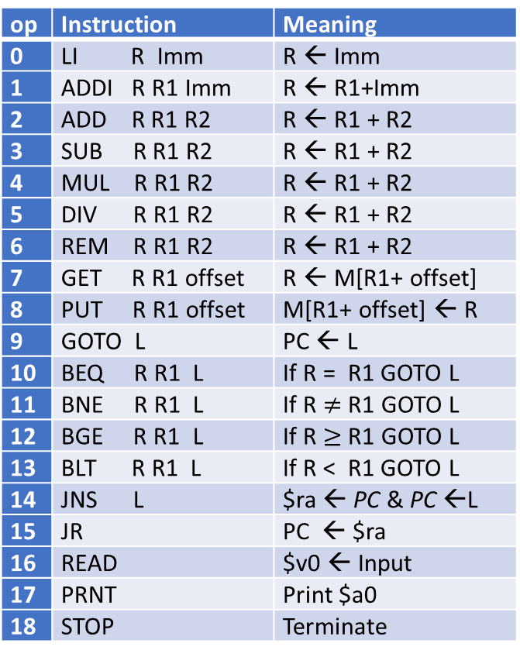
Instruction Set
Three R2R
op | Instruction | Meaning
0 | LI R Imm | R ← Imm
1 | ADDI R R1 Imm | R ← R1+Imm
2 | ADD R R1 R2 | R ← R1 + R2
3 | SUB R R1 R2 | R ← R1 + R2
4 | MUL R R1 R2 | R ← R1 + R2
5 | DIV R R1 R2 | R ← R1 + R2
6 | REM R R1 R2 | R ← R1 + R2
7 | GET R R1 offset | R ← M[R1+ offset]
8 | PUT R R1 offset | M[R1+ offset] ← R
9 | GOTO L | PC ← L
10 | BEQ R R1 L | If R = R1 GOTO L
11 | BNE R R1 L | If R $≠$ R1 GOTO L
12 | BGE R R1 L | If R $≥$ R1 GOTO L
13 | BLT R R1 L | If R < R1 GOTO L
14 | JNS L | $ra ← PC & PC ←L
15 | JR | PC ← $ra
16 | READ | $v0 ← Input
17 | PRNT | Print $a0
18 | STOP | Terminate
Imm: 16-bit 2’s compliment
offset: Imm or address of variable
PC: Program counter
R, R1: Registers
L: Label
M[R]: Memory content at address R

Slide 21
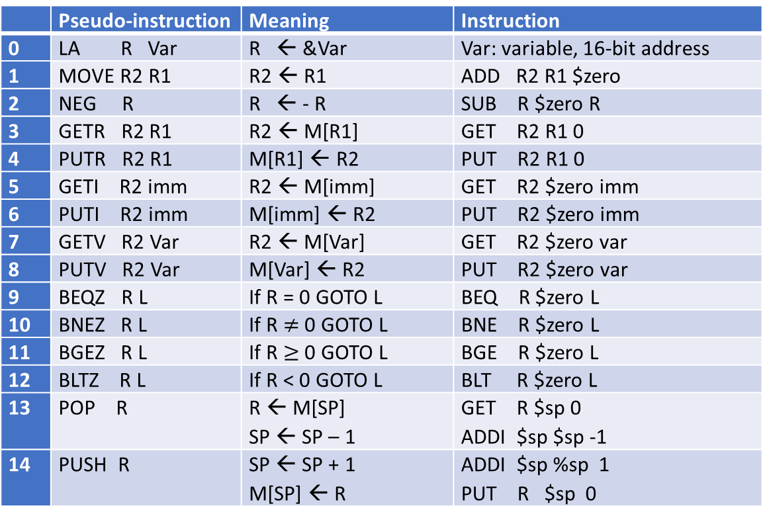
Pseudo-Instructions 3A R2R
 | Pseudo-instruction | Meaning | Instruction
0 | LA R Var | R ← &Var | Var: variable, 16-bit address
1 | MOVE R2 R1 | R2 ← R1 | ADD R2 R1 $zero
2 | NEG R | R ← - R | SUB R $zero R
3 | GETR R2 R1 | R2 ← M[R1] | GET R2 R1 0
4 | PUTR R2 R1 | M[R1] ← R2 | PUT R2 R1 0
5 | GETI R2 imm | R2 ← M[imm] | GET R2 $zero imm
6 | PUTI R2 imm | M[imm] ← R2 | PUT R2 $zero imm
7 | GETV R2 Var | R2 ← M[Var] | GET R2 $zero var
8 | PUTV R2 Var | M[Var] ← R2 | PUT R2 $zero var
9 | BEQZ R L | If R = 0 GOTO L | BEQ R $zero L
10 | BNEZ R L | If R $≠$ 0 GOTO L | BNE R $zero L
11 | BGEZ R L | If R $≥$ 0 GOTO L | BGE R $zero L
12 | BLTZ R L | If R < 0 GOTO L | BLT R $zero L
13 | POP R | R ← M[SP] SP ← SP – 1 | GET R $sp 0 ADDI $sp $sp -1
14 | PUSH R | SP ← SP + 1 M[SP] ← R | ADDI $sp %sp 1 PUT R $sp 0

Slide 22
Program Structure and Syntax (1)
Every program contains three sections and separated by END
  Data (optional)
  Code
  Input (optional)
Data (Declarations)
  One variable definition per line
  ID (identifier) is the variable name.
  Type is a positive integer
    Type = 1, ID is a scalar variable
    Type > 1, ID is an array variable
  Value is up to Type initial integers of ID. If less than Type initial values are provided, default initial values are used.
[Data]
END
Code
END
[Input]
ID Type [Value]
[Label:] Instruction
Number (integer)

Slide 23
Program Structure and Syntax (2)
Code (Instructions)
  One instruction per line
  Label is optional. It must be followed by ‘:’ immediately. There is no space between Label and ‘:’.
  Instruction is any instruction, including pseudo-instruction.
Input:
  One input value per line.
  Number is any integer.
Comments:
  Any text starting from // to the end of the line will be considered as comments
[Data]
END
Code
END
[Input]
ID Type [Value]
[Label:] Instruction
Number (integer)

Slide 24
Example 1: Compute sum of absolute values of elements in an array
C++ code
int main() {
int DAT [ 9] = {10, 20, 30, -40, 50, 60, 70, 80, -90} //array
int N = 9; //number of elements in array
int SUM = 0; //sum
int I;
for (I = 0; I < N; I++)
if (DAT < 0)
DAT[I] = - DAT[I];
SUM = SUM + DAT[I];
std::cout << SUM;
return 0;
}

Slide 25
Example 1: Two-Address M2M Code 1/2
//Declaration
PDAT 1 DAT //Pointer to the array DAT
SUM 1 0 //Sum
NUM 1 9 //Number of elements in the array
TMP 1 0 //Temporary location
DAT 9 10 20 30 -40 50 60 70 80 -90 //Array of integers
END

Slide 26
Two-Address M2M Code
//Instructions
L1: BEQZ NUM L3 //If NUM=0, done
GET TMP PDAT //Get an element from array
BGEZ TMP L2 //if positive, skip
NEG TMP //TMP = -TMP
L2: ADD SUM TMP //Add to sum
ADDI REM -1 //Decrease NUM by one
ADDI PDAT 1 //Point to next array element
GOTO L1 //Next iteration
L3: MOVE OUTPUT SUM //Print sum on screen
PRNT
STOP //Terminate program
END
//Inputs
//None

Slide 27
Example 1: Two-Address R2R Code 1/2
//Declaration
SUM 1 0 //Sum
NUM 1 9 //Number of elements in the array
SUM 1 0 //Sum
DAT 9 10 20 30 -40 50 60 70 80 -90 //Array of integers
END

Slide 28
Two-Address R2R Code
//Instructions
LA $s0 NUM //$s0 = address of NUM
GET $t0 $s0 //$t0 = NUM
LA $s0 DAT //$s0 = address of DAT
LI $a0 0 //$a0(sum) = 0
L1: BEQZ $t0 L3 //If no remaining element, done
GET $t1 $s0 //Get an array element into $t1
BGEZ $t1 L2 //If positive, skip
NEG $t1 //Else, negate $t1
L2: ADD $a0 $t1 //Add to $a0(sum)
ADDI $t0 -1 //Decrease number of remaining elements
ADDI $s0 1 //Next element
GOTO L1 //Next iteration
L3: LA $s0 SUM //$s0 = address of SUM
PUT $a0 $s0 //Save the sum to SUM
PRNT //Print sum on screen
STOP //Terminate program
END
//Input
//None

Slide 29
Example 1: Three-Address M2M Code 1/2
//Declaration
SUM 1 0 //Sum
NUM 1 9 //Number of elements in the array
TMP 1 0 //Temporary location
IND 1 0 //Array Index
DAT 9 10 20 30 -40 50 60 70 80 -90 //Array of integers
END

Slide 30
Three-Address M2M Code 2/2
//Instructions
L1: BEQ IND NUM L3 //If IND=NUM, done
GET TMP DAT IND //Get an array element into TMP
BGE TMP ZERO L2 //If positive, skip
NEG TMP //Else, negate
L2: ADD SUM SUM TMP //Add to sum
ADDI IND IND 1 //Increase index IND by one
GOTO L1 //Next iteration
L3: MOVE OUTPUT SUM //Move sum into OUTPUT
PRNT //Print sum on screen
STOP //Terminate program
END
//Inputs
//None

Slide 31
Example 1: Three-Address R2R Code 1/2
//Declaration
SUM 1 0 //Sum
NUM 1 9 //Number of elements in the array
DAT 9 10 20 30 -40 50 60 70 80 -90 //Array of integers
END

Slide 32
Three-Address R2R Code 2/2
//Instructions
LI $t0 0 //$t0(index) = 0
GET $t1 $zero NUM //$t1 = NUM
LI $a0 0 //$a0(sum)=0
L1: BEQ $t0 $t1 L3 //If index=NUM, done
GET $t2 $t0 DAT //Get an array element in $t2
BGEZ $t2 L2 //If positive, skip
NEG $t2 //Else, negate
L2: ADD $a0 $a0 $t2 //Add $t2 to $a0(sum)
ADDI $t0 $t0 1 //Increase index
GOTO L1 //Next iteration
L3: PUT $a0 $zero SUM //Save the sum to SUM
PRNT //Print sum on screen
STOP //Terminate program
END
//Input
//None

Slide 33
Example 1: Compute sum of absolute values of elements in an array: Comparison (1)
 | Loop control | Array access
2A M2M | Using the length of the array to control the loop. In each loop iteration, the length is deceased by one. When the length becomes zero, the loop ends. | Using a pointer to access array element. In each loop iteration, move the pointer to point to next array element.
2A R2R
3A M2M | Using the array index to control the loop. In each loop iteration, the index is increased by one. When the index becomes to equal the array length, then loop end. | Using array index to access the array elements using the array base address plus the index. In each loop iteration, the index is increased by one .
3A R2R

Slide 34
Example 1: Compute sum of absolute values of elements in an array: Comparison (2)
 | NI | LI | PS | NIMA | NDMA | TNMA
2A M2M | 17 | 39 bits | 663 bits | 106 (11N+7) | 190 (20N+10) | 296
2A R2R | 19 | 26 bits | 494 bits | 108 (11N+9) | 11 (1N+2) | 119
3A M2M | 10 | 56 bits | 560 bits | 67 (7N+4) | 141 (15N+6) | 208
3A R2R | 13 | 31 bits | 403 bits | 70 (7N+7) | 11 (1N+2) | 81
NI Number of instructions
LI Length of instruction
PS Program size
NIMA Number of instructions fetched from memory during execution
NDMA Number of data memory accesses during execution
TNMA Total number of memory accesses during execution

Slide 35
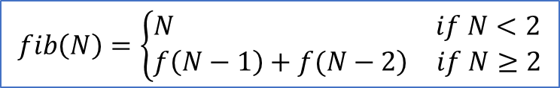
Example 2: Compute Fibonacci Number fib(N), Where N is an Input
$$fib\left(N\right)=\left\{\begin{aligned}&\begin{matrix}N & if N<2\end{matrix} \\ &\begin{matrix}\left.f\left(N−1\right)+f(N−2\right) & if N≥2\end{matrix}\end{aligned}\right.$$
Mathematics formula
int I, A, B, C, N
std::cin >> N;
if (N < 2)
C = N;
else {
A = 0; B = 1;
for (I = 2; I <= N; I++) {
C = B + A; A = B; B = C;
}
}
std::cout << C;
C++ code using a loop

Slide 36
Example 2:
Loop Solution
//Instruction
READ //Input
MOVE N INPUT //N = Input
MOVE C N //C=N
ADDI N -2 //N = N-2
BLTZ N L2 //If N<2, done
L1: MOVE C B //C = B
ADD C A //C = C + A
MOVE A B //A = B
MOVE B C //B = C
ADDI N -1 //N--
BGEZ N L1 //If N >=0
L2: MOVE OUTPUT C
PRNT //Print C
STOP //Terminate
END
10
Two Address M2M Code
//Declarations
N 1 0 //N
C 1 0 //f(N)
B 1 1 //f(N-1)
A 1 0 //f(N-2)
END

Slide 37
Example 2:
Loop Solution
//Instruction
READ //Input
MOVE N INPUT //N = Input
MOVE C N //C = N
ADDI N N -2 //N = N-2
BLT N ZERO L2 //If N<2, done
L1: ADD C B A //C = B + A
MOVE A B //A = B
MOVE B C //B = C
ADDI N N -1 //N--
BGE N ZERO L1 //if N >=0 continue
L2: MOVE OUTPUT C //OUTPUT = C
PRNT //Print OUTPUT
STOP //Terminate
END
10
Three Address M2M Code
//Declarations
N 1 0 //N
C 1 0 //f(N)
B 1 1 //f(N-1)
A 1 0 //f(N-2)
END

Slide 38
Example 2:
Loop Solution
END
READ //$v0 = N
MOVE $a0 $v0 //$a0(C) = N
ADDI $v0 -2 //$v0 = $v0-2
BLTZ $v0 L2 //If N<2, done
LI $t1 0 //$t1(A) = 0
LI $t2 1 //$t2(B) = 1
L1: MOVE $a0 $t2 //$t3(C) = B,
ADD $a0 $t1 //C = B+A
MOVE $t1 $t2 //A = B
MOVE $t2 $a0 //B = C
ADDI $v0 -1 //N--
BGEZ $v0 L1 //if N >= 0, continue
L2: PRNT //Print result ($a0 )
STOP //Terminate
END
10
Two Address R2R Code
Register assignment
$v0: N, $t1: A, $t2: B,
$a0: C (f(N))

Slide 39
Example 2:
Loop Solution
END
READ //$v0 = N
MOVE $a0 $v0 //$a0(C) = N
ADDI $v0 $v0 -2 //$v0 = $v0-2
BLT $v0 $zero L2 //If N<2, done
LI $t1 0 //$t1(A) = 0
LI $t2 1 //$t2(B) = 1
L1: ADD $a0 $t1 $t2 //C = A+B
MOVE $t1 $t2 //A = B
MOVE $t2 $a0 //B = C
ADDI $v0 $v0 -1 //N--
BGE $v0 $zero L1 //if N >= 0, continue
L2: PRNT //Print result ($a0)
STOP //Terminate
END
10
Three Address R2R Code
Register assignment
$v0: N, $t1: A, $t2: B,
$a0: C (f(N))

Slide 40
Example 2: Compute Fibonacci using a loop: Comparison (1)
3-Address | 2-Address
C = A + B A = B B = C | C = B C = C + A A = B B = C

Slide 41
Example 2: Compute Fibonacci using a loop: Comparison (2)
 | Branch and Loop control
2A M2M | If N-2 < 0, then f(N) = N, else use a loop to compute f(N). Using N-2 to control the loop. In each loop iteration, N-2 is deceased by one. When it is greater or equal to zero, the loop continues.
2A R2R
3A M2M
3A R2R

Slide 42
Example 2: Compute Fibonacci using a loop: Comparison (3)
 | NI | LI | PS | NIMA | NDMA | TNMA
2A M2M | 32 | 39 bits | 1,248 | 152 (15(N-1)+17) | 299 (30(N-1)+29) | 451
2A R2R | 26 | 26 bits | 676 | 146 (15(N-1)+11) | 0 | 146
3A M2M | 13 | 56 bits | 728 | 53 (5(N-1)+8) | 132 (13(N-1)+15) | 185
3A R2R | 13 | 31 bits | 403 | 53 (5(N-1)+8) | 0 | 53
NI Number of instructions
LI Length of instruction
PS Program size
NIMA Number of instructions fetched from memory during execution
NDMA Number of data memory accesses during execution
TNMA Total number of memory accesses during execution

Slide 43
Example 2: C++ Code Using Function
int N;
int fib(int N) {
int I, A, B, C;
if (N < 2)
return N;
else {
A = 0; B = 1;
for (I = 2; I <= N; I++) {
C = B + A; A = B; B = C;
}
}
return C;
}
cin >> N;
C = fib(N);
cout << C;
int N;
int fib(int N) {
if (N < 2)
return N;
else
return f(N-1)+f(N-2);
}
cin >> N;
C = fib(N);
cout << C;
Recursive function
Non-recursive function

Slide 44
Example 2: Using Function (Simplified)
Two Address M2M Code 1/2
Activation Record
END
READ
PUSH INPUT
JNS Fib //call Fib
POP OUTPUT
PRNT
STOP
Addr | Name | Explanation
$-1 | N/Fib(N)/C | Input/output
$ | RA | Return Address
$+1 | A | Local variable
$+2 | B | Local variable
$+3 | SN | Local variable

Slide 45
Two Address M2M Code 2/2
Fib: MOVE $+3 $-1 //SN = N
ADDI $+3 -2 //SN = SN-2
BLTZ $+3 L2 //if SN < 0, done
LI $+1 0 //A = 0
LI $+2 1 //B = 1
L1: MOVE $-1 $+2 //C = B
ADD $-1 $+1 //C = C + A
MOVE $+1 $+2 //A = B
MOVE $+2 $-1 //B = C
ADDI $+3 -1 //SN = SN-1
BGEZ $+3 L1 //If SN >= 0, continue
L2: JR
END
10

Slide 46
Example 2: Using Function
Three Address M2M Code 1/2
Activation Record
END
READ
PUSH INPUT
JNS Fib //call Fib
POP OUTPUT
PRNT
STOP
Addr | Name | Explanation
$-1 | N/Fib(N)/C | Input/output
$ | RA | Return Address
$+1 | A | Local variable
$+2 | B | Local variable
$+3 | SN | Local variable

Slide 47
Three Address M2M Code 2/2
Fib: ADDI $+3 $-1 -2 //SN = N-2
BLTZ $+3 L2 //if SN < 0, done
LI $+1 0 //A = 0
LI $+2 1 //B = 1
L1: ADD $-1 $+1 $+2 //C = A+B
MOVE $+1 $+2 //A = B
MOVE $+2 $-1 //B = C
ADDI $+3 $+3 -1 //SN = SN-1
BGEZ $+3 L1 //If SN >= 0, continue
L2: JR
END
10

Slide 48
Example 2:
Using Function
No
Activation Record
Is needed
Two Address R2R Code
//compute f(N)
Fib: MOVE $v0 $a0 //$v0(C) = $a0(N)
ADDI $a0 -2 //N = N-2
BLTZ $a0 L2 //If N<2, done
LI $t1 0 //$t1(A) = 0
LI $t2 1 //$t2(B) = 1
L1: MOVE $v0 $t2 //C = B
ADD $v0 $t1 //C = C+A
MOVE $t1 $t2 //A = B
MOVE $t2 $v0 //B = C
ADDI $a0 -1 //N = N-1
BGEZ $a0 L1
L2: JR
END
10
//Declarations
//None
END
//Instructions
READ //$v0 = N
MOVE $a0 $v0 //$a0 = $v0
JNS Fib //$v0 = Fib(N)
MOVE $a0 $v0 //$a0=$v0
PRNT //Print $a0
STOP
Register assignment
$a0: input to function: N
$v0: output from function: C
$t1: A, $t2: B

Slide 49
Example 2:
Using Function
No
Activation Record
Is needed
//compute f(N)
Fib: MOVE $v0 $a0 //$v0(C) = $a0(N)
ADDI $a0 $a0 -2 //N = N-2
BLTZ $a0 L2 //If N<2, done
LI $t1 0 //$t1(A) = 0
LI $t2 1 //$t2(B) = 1
L1: ADD $v0 $t1 $t2 //C = A+B
MOVE $t1 $t2 //A = B
MOVE $t2 $v0 //B = C
ADDI $a0 $a0 -1 //N = N-1
BGEZ $a0 L1
L2: JR
END
10
Three Address R2R Code
//Declarations
//None
END
//Instructions
READ //$v0 = N
MOVE $a0 $v0 //$a0 = $v0
JNS Fib //$v0 = Fib(N)
MOVE $a0 $v0 //$a0=$v0
PRNT //Print $a0
STOP
Register assignment
$a0: input to function: N
$v0: output from function: C
$t1: A, $t2: B

Slide 50
Example 2: Compute Fibonacci using a function: Comparison (1)
 | Stack Frames and parameter passing
2A M2M | 1 input/output, 1 return address, 3 local variables, accessed via $
3A M2M | Same as 2A M2M
2A R2R | No stack frame used. Using registers to pass input/output, use registers for local variables
3A R2R | Same as 2A R2R
Parameter passing and local variables for architecture with in general-purpose
registers can utilize these registers. Otherwise, stack is usually required.

Slide 51
Example 2: Compute Fibonacci using a function: Comparison (2)
 | NI | LI | PS | NIMA | NDMA | TNMA
2A M2M | 32 | 39 bits | 1,248 | 152 (15(N-1)+17) | 303 (30(N-1)+33) | 455
2A R2R | 36 | 26 bits | 936 | 156 (15(N-1)+21) | 0 | 156
3A M2M | 16 | 56 bits | 896 | 56 (5(N-1)+11) | 143 (13(N-1)+26) | 199
3A R2R | 17 | 31 bits | 527 | 57 (5(N-1)+12) | 0 | 57
NI Number of instructions
LI Length of instruction
PS Program size
NIMA Number of instructions fetched from memory during execution
NDMA Number of data memory accesses during execution
TNMA Total number of memory accesses during execution

Slide 52
Example 2: C++ Code with Using Recursive Function
int N;
int fib(int N) {
int I, A, B, C;
if (N < 2)
return N;
else {
A = 0; B = 1;
for (I = 2; I <= N; I++) {
C = B + A; A = B; B = C;
}
}
return C;
}
cin >> N;
C = fib(N);
cout << C;
int N;
int fib(int N) {
if (N < 2)
return N;
else
return f(N-1)+f(N-2);
}
cin >> N;
C = fib(N);
cout << C;
Recursive function
Non-recursive function

Slide 53
Example 2: Using Recursive Function
Two Address M2M Code ½
Activation Record
Addr | Name | Explanation
$-1 | N/Fib(N) | Input/output
$ | RA | Return Address
$+1 | (N-2)/Fib(N-2) | Input/output
$+2 | (N-1)/Fib(N-1) | Input/output
END
READ
PUSH INPUT
JNS Fib //call Fib
POP OUTPUT
PRNT
STOP

Slide 54
Two Address M2M Code 2/2: Fib_Rec_Func
//Compute f(N)
Fib: MOVE $+1 $-1 //$+1 = N
ADDI $+1 -2 //$+1 = N-2
BLTZ $+1 L1 //If N < 2
ADDI SP 1 //PUSH N-2
JNS Fib //compute F(N-2)
ADDI SP 1 //PUSH N-1
MOVE $+0 $-3
ADDI $+0 -1
JNS Fib //Compute F(N-1)
ADDI SP -2 //POP 2 times
MOVE $-1 $+1 //F(N) = F(N-2) + F(N-1)
ADD $-1 $+2
L1: JR
END
10

Slide 55
Addr | Name | Explanation
$-1 | N/Fib(N) | Input/output
$ | RA | Return Address
$+1 | (N-2)/Fib(N-2) | Input/output
$+2 | (N-1)/Fib(N-1) | Input/output
After Fib(N) is called
Addr | Name | Explanation
$-2 | N/Fib(N) | Input/output
$-1 | RA | Return Address
$ | (N-2)/Fib(N-2) | Input/output
$+1 | (N-1)/Fib(N-1) | Input/output
After Fib(N-2) is called
inside Fib(N)
Addr | Name | Explanation
$-3 | N/Fib(N) | Input/output
$-2 | RA | Return Address
$-1 | (N-2)/Fib(N-2) | Input/output
$ | (N-1)/Fib(N-1) | Input/output
After Fib(N-1) is called
inside Fib(N)

Slide 56
Example 2: Using Recursive Function
Three Address M2M Code 1/2
Activation Record
END
//Instruction
READ //Read Input
PUSH INPUT //N = Input
JNS Fib //call Fib
POP OUTPUT
PRNT //print C
STOP
Addr | Name | Explanation
$-1 | N/Fib(N) | Input/output
$ | RA | Return Address
$+1 | (N-2)/Fib(N-2) | Input/output
$+2 | (N-1)/Fib(N-1) | Input/output

Slide 57
Three Address M2M Code 2/2: Fib_Rec_Func
//Compute f(N)
Fib: ADDI $+1 $-1 -2 //$+1 = N-2
BLT $+1 ZERO L1 //If N < 2
ADDI SP SP 1 //PUSH N-2
JNS Fib //compute F(N-2)
ADDI SP SP 1 //PUSH N-1
ADDI $+0 $-3 -1 //
JNS Fib //Compute F(N-1)
ADDI SP SP -2 //POP 2 times
ADD $-1 $+1 $+2 //F(N) = F(N-2) + F(N-1)
L1: JR
END
//Input
10

Slide 58
Addr | Name | Explanation
$-1 | N/Fib(N) | Input/output
$ | RA | Return Address
$+1 | (N-2)/Fib(N-2) | Input/output
$+2 | (N-1)/Fib(N-1) | Input/output
After Fib(N) is called
Addr | Name | Explanation
$-2 | N/Fib(N) | Input/output
$-1 | RA | Return Address
$ | (N-2)/Fib(N-2) | Input/output
$+1 | (N-1)/Fib(N-1) | Input/output
After Fib(N-2) is called
inside Fib(N)
Addr | Name | Explanation
$-3 | N/Fib(N) | Input/output
$-2 | RA | Return Address
$-1 | (N-2)/Fib(N-2) | Input/output
$ | (N-1)/Fib(N-1) | Input/output
After Fib(N-1) is called
inside Fib(N)

Slide 59
Example 2: Using Recursive Function
Two Address R2R Code 1/2
Activation Record
//Declarations
//None
END
//Instructions
READ //$v0 = N
MOVE $a0 $v0 //$a0 = $v0
JNS Fib //$v0 = Fib(N)
MOVE $a0 $v0 //$a0=$v0
PRNT //Print $a0
STOP
 | Saved register | Used for
 | $a0 | Input N
 | $s0 | Fib(N-2)
 | $ra | Return address

Slide 60
Two Address R2R Code 2/2: Fib_Rec_FUnc
//compute $v0 = Fib(N)
Fib: PUSH $a0
PUSH $s0
PUSH $ra
MOVE $v0 $a0 //$v0 = N
ADDI $a0 -2 //$a0 = N-2
BLTZ $a0 L2 //If N<2
JNS Fib //Compute $v0 = Fib(N-2)
MOVE $s0 $v0 //$s0 = Fib(N-2)
ADDI $a0 1 //$a0 = N-1
JNS Fib //Compute $v0 = Fib(N-1)
ADD $v0 $s0 //$v0 = Fib(N-1) + Fib(N-2)
L2: POP $ra
POP $s0
POP $a0
JR
END
10

Slide 61
Example 2: Using Recursive Function
Three Address R2R Code 1/2
Activation Record
//Declarations
//None
END
//Instructions
READ //$v0 = N
MOVE $a0 $v0 //$a0 = $v0
JNS Fib //$v0 = Fib(N)
MOVE $a0 $v0 //$a0=$v0
PRNT //Print $a0
STOP
 | Saved register | Used for
 | $a0 | Input N
 | $s0 | Fib(N-2)
 | $ra | Return address

Slide 62
Three Address R2R Code 2/2 Fib_Rec_Func
Fib: PUT $a0 $sp 1 //push $a0
PUT $s0 $sp 2 //push $s0
PUT $ra $sp 3 //push $ra
ADDI $sp $sp 3
MOVE $v0 $a0 //compute Fib(N)
ADDI $a0 $a0 -2 //$a0 = N-2
BLT $a0 $zero L1 //If N<2
JNS Fib //Compute $v0 = Fib(N-2)
MOVE $s0 $v0 //$s0 = Fib(N-2)
ADDI $a0 $a0 1 //$a0 = N-1
JNS Fib //Compute $v0 = fib(N-1)
ADD $v0 $v0 $s0 //$v0=fib(N-1)+fib(N-2)
L1: ADDI $sp $sp -3
GET $a0 $sp 1 //pop $a0
GET $s0 $sp 2 //pop $s0
GET $ra $sp 3 //pop $ra
JR
END
//inputs
10

Slide 63
Example 2: Compute Fibonacci using a recursive function: Comparison (1)
 | Stack frame
2A M2M | 1 input/output, 1 return address, and 2 calls Fib(N-1) and Fib(N-2). Accessed via $. But value of $ is changing when push or pop
3A M2M | Same as 2A M2M
2A R2R | 3 saved registers, $a0, $s0, $ra
3A R2R | Same as 2A R2R

Slide 64
Example 2: Compute Fibonacci using a recursive function: Comparison (2)
10 | 9 | 8 | 7 | 6 | 5 | 4 | 3 | 2 | 1 | 0
1 | 1 | 2 | 3 | 5 | 8 | 13 | 21 | 34 | 55 | 34
X = Fib(1) + … + Fib(N-1) = 1+1+2+3+5+8+13+21+34 = 88
Y = Fib(N)+Fib(N-1) = 55+34 = 89
 | NI | LI | PS | NIMA | NDMA | TNMA
2A M2M | 30 | 39 bits | 1,170 bits | 8+22X+7Y = 2,567 | 16+50X+15Y = 5,751 | 8,318
2A R2R | 43 | 26 bits | 1,118 | 16+19X+8Y = 2,400 | 0+6X+0Y = 525 | 2,925
3A M2M | 18 | 56 bits | 1,008 | 8+10X+3Y = 1,155 | 16+27X+5Y = 3,282 | 4,437
3A R2R | 22 | 31 bits | 686 | 6+11X+5Y = 1,419 | 0+6X+0Y = 525 | 1,944

Slide 65
Conclusions
Several computer architecture simulators are presented.
  Similar instruction set
  Similar assembly language program structure and syntax
Several example assembly language programs are also given to illustrate many basic programming concepts and techniques at the assembly language level
  Dealing with array, loop, function call and return, parameter passing, local variables, stack frame, and recursion
  Register selection and usage
  Compute using different instruction formats
  Access array using either indirect or based memory addressing modes.

