Slide 1
CVMSA Workshop
Week 3
Dr. Melanie Martin
October 1, 2013

Slide 2
Topics
Math study skills and resources
Computer Science resources and tools
Research topics in Math and Computer Science

Slide 3
Why Math?
The language of science
Allows us to precisely describe the essence of nature
  Abstraction
    Solve one problem instead of infinitely many
    Crowning achievement of human intelligence?
  Laws of motion
  Spread of disease
Helps us think carefully and clearly
It is everywhere!

Slide 4
Why Computer Science?
Problem solving
Programming languages help us think precisely and carefully
Develop and reason about algorithms
Automation of tedious and error-prone tasks
Great expansion of our abilities
  Compute
  Store
  Filter
Filtering information is becoming a huge challenge
Computers are everywhere!

Slide 5
Studying to Succeed
Some things that work
  Go to class
    Pay attention
    Take notes
    Ask questions
    Be involved in the material
  Do all assigned work
    Set up regular work times
    Form study groups
    Get help when needed
    Go to office hours
    Do more than assigned work

Slide 6
Stepping back
Time management
  Balance school, work, family, friends, other activities
  Be realistic about what you can do
  Success in Math and Science takes time
  Keep records of how you spend your time
Assignment
  For the next week, print out or make a calendar
  Keep track up to 10 minute increments of what you do
  At the end of the week analyze it
Don’t multitask: FOCUS

Slide 7
Make it part of your life
Talk to people about what you are studying
  When you are exercising
  When you are eating
  When you are studying
  In the lab
Talk to yourself about what you are studying
  On walks
  In line at bank or stores
  In the shower
  Write about it
  Practice talking about it

Slide 8
Grades Matter
Get help when you need it
  The sooner the better
Make sure you have learned the prerequisites
Be realistic about your course load
Talk to your professors about your concerns
Find mentors who have been successful
  CVMSA
  FMP
  Student Clubs
  Commons
  Department Advisor
Know your catalog and your options

Slide 9
NMSU Student Success Center
http://ssc.nmsu.edu/services/walk-incenter-resources/
Learning Strategy Resources
  Listening and Note-Taking
  Study Reading and Reading Rate
  Time Management and Procrastination
  Learning Styles
  Math Study Skills
    http://mathcs.slu.edu/undergrad-math/success-in-mathematics
    http://www.cs.csustan.edu/~mmartin/pubs/calc1.html
  Study Skills for Academic Success

Slide 10
Some more strategies
Tell stories
  Humans are good at remembering stories
  Drama and motivation
  Pretend you care
  Example: standard deviation
Make friends with your problems
  You should be able to recognize them
  Greet them enthusiastically
  Don’t look down or cross the street to avoid them
  Repetition breeds familiarity
  Spend time with them

Slide 11
Where to get help on course material
Ask questions in class
Go to office hours
Ask fellow students
Form a study group
The Commons (N 124)
Tutoring Center (Library)
LSAMP Workshops (Math and Chemistry)
Clubs (Math, Chemistry, Biology, Physics…)
Online
  Wolfram Alpha - http://www.wolframalpha.com
  Khan Academy - http://www.khanacademy.org

Slide 12
When in doubt Experiment
Go back to the definitions
Work on a simple example to see how it works
Walk through it carefully
Poke around the edges
Write a program to simulate it
Look in your tool box
Play with it
Have fun
Engage your curiosity

Slide 14
Tools
Excel
Some useful tools
Why R?
Programming

Slide 15
Excel
Spreadsheets are very useful
Learn how to use them

Slide 16
Some Useful Tools
On Campus
Open Source
SPSS
  Statistical package
  OIT Labs
Mathematica
  Calculus lab
Matlab
  Coming soon
  Some licenses in CS lab
R
  Statistical Computing Project
  http://www.r-project.org
WEKA
  Data mining and machine learning
  http://www.cs.waikato.ac.nz/ml/weka/
NLTK
  Natural Language Toolkit
  http://nltk.org/index.html

Slide 18
Why R?
Based on slides by Matthew Keller who cribbed some material from: UCLA Academic Technology Services Technical Report Series (by Patrick Burns) and presentations (found online) by Bioconductor, Wolfgang Huber and Hung Chen, & various Harry Potter websites

Slide 19

R programming language is a lot like magic... except instead of spells you have functions.
R, And the Rise of the Best Software Money Can’t Buy

Slide 20


=
muggle
SPSS and SAS users are like muggles. They are limited in their ability to change their environment. They have to rely on algorithms that have been developed for them. The way they approach a problem is constrained by how SAS/SPSS employed programmers thought to approach them. And they have to pay money to use these constraining algorithms.

Slide 21
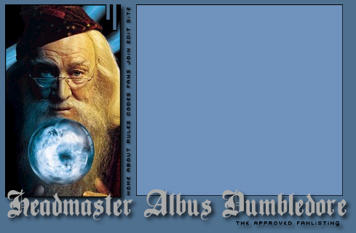

=
wizard
R users are like wizards. They can rely on functions (spells) that have been developed for them by statistical researchers, but they can also create their own. They don’t have to pay for the use of them, and once experienced enough (like Dumbledore), they are almost unlimited in their ability to change their environment.

Slide 22
History of R
S: language for data analysis developed at Bell Labs circa 1976
Licensed by AT&T/Lucent to Insightful Corp. Product name: S-plus.
R: initially written & released as an open source software by Ross Ihaka and Robert Gentleman at U Auckland during 90s (R plays on name “S”)
Since 1997: international R-core team ~15 people & 1000s of code writers and statisticians happy to share their libraries! AWESOME!

Slide 23
“Open source”... that just means I don’t have to pay for it, right?
No. Much more:
  Provides full access to algorithms and their implementation
  Gives you the ability to fix bugs and extend software
  Provides a forum allowing researchers to explore and expand the methods used to analyze data
  Is the product of 1000s of leading experts in the fields they know best. It is CUTTING EDGE.
  Ensures that scientists around the world - and not just ones in rich countries - are the co-owners to the software tools needed to carry out research
  Promotes reproducible research by providing open and accessible tools
  Most of R is written in… R! This makes it quite easy to see what functions are actually doing.

Slide 24
What is it?
R is an interpreted computer language.
  Most user-visible functions are written in R itself, calling upon a smaller set of internal primitives.
  It is possible to interface procedures written in C, C+, or FORTRAN languages for efficiency, and to write additional primitives.
  System commands can be called from within R
R is used for data manipulation, statistics, and graphics. It is made up of:
  operators (+ - <- * %*% …) for calculations on arrays & matrices
  large, coherent, integrated collection of functions
  facilities for making unlimited types of publication quality graphics
  user written functions & sets of functions (packages); 800+ contributed packages so far & growing

Slide 25
R
Advantages Disadvantages
Fast and free.
State of the art: Statistical researchers provide their methods as R packages. SPSS and SAS are years behind R!
2nd only to MATLAB for graphics.
Active user community
Excellent for simulation, programming, computer intensive analyses, etc.
Forces you to think about your analysis.
Interfaces with database storage software (SQL)

Slide 26
R
Advantages Disadvantages
Fast and free.
State of the art: Statistical researchers provide their methods as R packages. SPSS and SAS are years behind R!
2nd only to MATLAB for graphics.
Active user community
Excellent for simulation, programming, computer intensive analyses, etc.
Forces you to think about your analysis.
Interfaces with database storage software (SQL)
Not user friendly @ start - steep learning curve, minimal GUI.
No commercial support; figuring out correct methods or how to use a function on your own can be frustrating.
Easy to make mistakes and not know.
Working with large datasets is limited by RAM
Data prep & cleaning can be messier & more mistake prone in R vs. SPSS or SAS
Some users complain about hostility on the R listserve

Slide 27

Learning R....

Slide 28

R-help listserve....

Slide 29
R Commercial packages
Many different datasets (and other “objects”) available at same time
Datasets can be of any dimension
Functions can be modified
Experience is interactive-you program until you get exactly what you want
One stop shopping - almost every analytical tool you can think of is available
R is free and will continue to exist. Nothing can make it go away, its price will never increase.
One datasets available at a given time
Datasets are rectangular
Functions are proprietary
Experience is passive-you choose an analysis and they give you everything they think you need
Tend to be have limited scope, forcing you to learn additional programs; extra options cost more and/or require you to learn a different language (e.g., SPSS Macros)
They cost money. There is no guarantee they will continue to exist, but if they do, you can bet that their prices will always increase

Slide 30
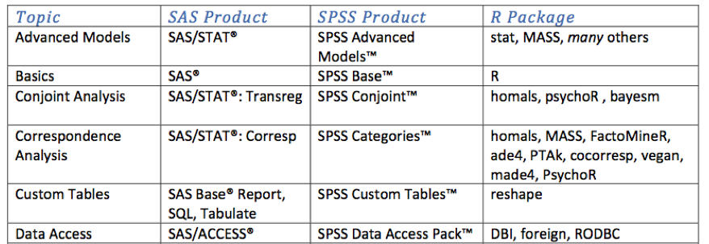
R vs SAS/SPSS
For the full comparison chart, see http://rforsasandspssusers.com/ by Bob Muenchen

Slide 31
There are over 800 add-on packages
(http://cran.r-project.org/src/contrib/PACKAGES.html)
This is an enormous advantage - new techniques available without delay, and they can be performed using the R language you already know.
Allows you to build a customized statistical program suited to your own needs.
Downside = as the number of packages grows, it is becoming difficult to choose the best package for your needs, & QC is an issue.

Slide 32
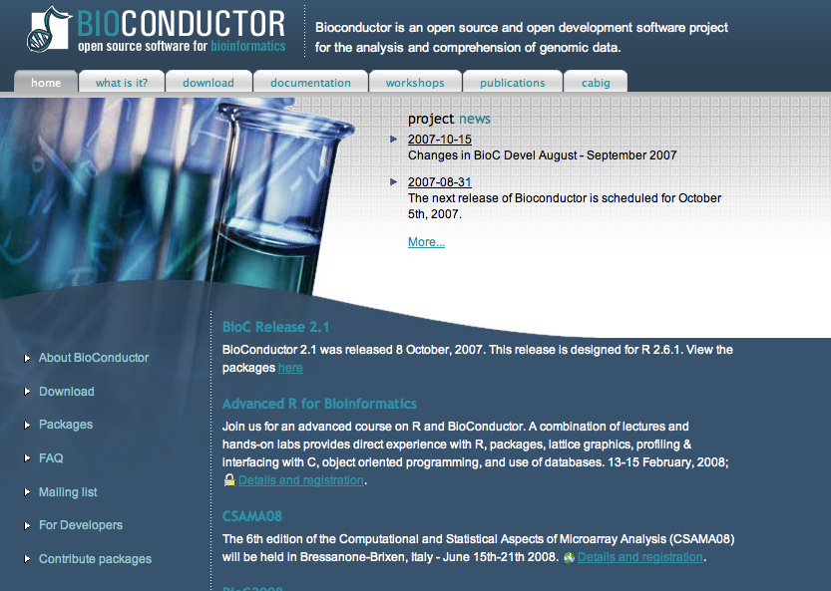
A particular R strength: genetics
Bioconductor is a suite of additional functions and some 200 packages dedicated to analysis, visualization, and management of genetic data
Much more functionality than software released by Affy or Illumina

Slide 33
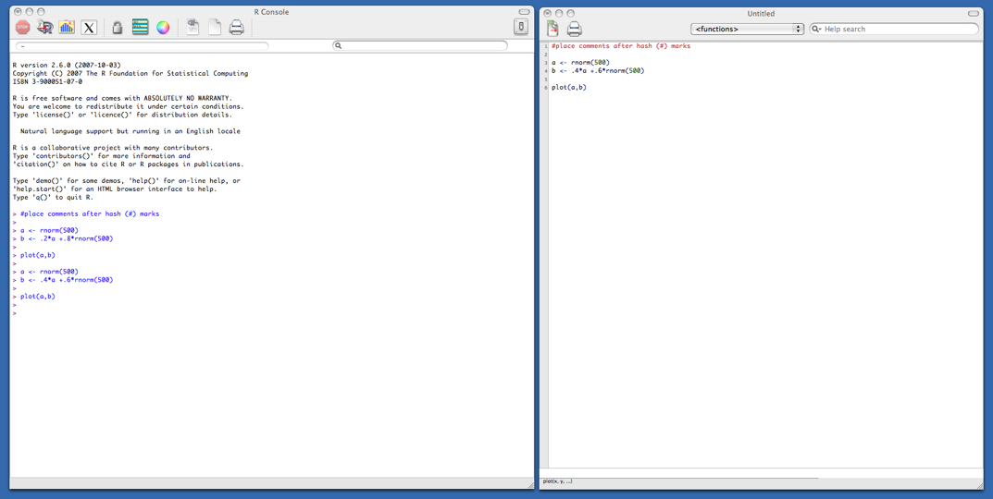
Typical R session
Start up R via the GUI or favorite text editor
Two windows:
  1+ new or existing scripts (text files) - these will be saved
  Terminal – output & temporary input - usually unsaved

Slide 34
Typical R session
R sessions are interactive
Write small bits of code here and run it

Slide 35
Typical R session
R sessions are interactive
Write small bits of code here and run it
Output appears here. Did you get what you wanted?

Slide 36
Typical R session
R sessions are interactive
Output appears here. Did you get what you wanted?
Adjust your syntax here depending on this answer.

Slide 37
Typical R session
R sessions are interactive
At end, all you need to do is save your script file(s) - which can easily be rerun later.

Slide 38
Learning R
Check out the course wikisite - lots of good manuals & links
Read through the CRAN website
Use http://www.rseek.org/ instead of google
Know your objects’ classes: class(x) or info(x)
Because R is interactive, errors are your friends!
?lm gives you help on lm function. Reading help files can be very… helpful
MOST IMPORTANT - the more time you spend using R, the more comfortable you become with it. After doing your first real project in R, you won’t look back. I promise.

Slide 40
Programming
Problem solving
Modeling
Simulation
Web Pages
Database
Scripting
And so much more!

Slide 41
But What Language?
Java - general
C++ - general
PHP - web
Javascript - web
Perl
Python
Lisp - functional
Prolog - logic
MySQL – database
MS Access - database
Flash - web
Objective C - apps
Visual Basic
And the list goes on…

Slide 42
Try Python
Python is a widely used general-purpose, high-level programming language. Its design philosophy emphasizes code readability, and its syntax allows programmers to express concepts in fewer lines of code than would be possible in languages such as C. The language provides constructs intended to enable clear programs on both a small and large scale. http://en.wikipedia.org/wiki/Python_%28programming_language%29
Sometimes described as an object oriented scripting language, it has excellent functionality for processing linguistic data, which is why I started using it.

Slide 43
Programming for Chemistry
Open Data, Open Source and Open Standards in chemistry: The Blue Obelisk five years on
  http://www.jcheminf.com/content/3/1/37
http://stackoverflow.com/questions/3195630/programming-in-chemistry selected responses:
  Python is also widely used in computational chemistry (structure visualization, molecular modeling, and cheminformatics).
  Dive into python
  Your best choice is almost certainly whatever your chemistry-major friends are using. In this case it might be Matlab, which is widely used in both natural sciences and engineering.
  I'd suggest Python. It's easy to learn and has very good library support for scientific programming such as Scipy/Numpy. It has a good support community and it very good for churning out code quickly.

Slide 44
Programming for Biology
Programming for Biologists
  http://www.programmingforbiologists.org/
  Introduction to Programming and Database Management for Biologists
    The course will be taught using Python for computer programming and MS Access for database management. No programming or database background is required.

Slide 45
Learning to Program
The code academy
  http://www.codecademy.com/tracks/python
Best to have something you want to do
Have to practice
It takes time
Keep the big picture in mind: problem solving

Slide 46
Learning to Program
Assignment statements
  computation
Control flow
  Choice
  Iteration
Data structures
  Lists
  Stack
  Queues
  Trees
  Tables

Slide 48
Doing research
Who is doing research in Math and CS
How to get started with a literature search
  Where to search
  How to search
  How to read
  How to keep track of it all

Slide 49
Math Research Broad Strokes
Algebra
Analysis
  Real
  Complex
Topology and Geometry
Set Theory and Logic (Foundations)
Combinatorics
Statistics
Applied Mathematics
Mathematics Education

Slide 50
CS Research Broad Strokes
Artificial Intelligence (AI)
Computer Architecture & Engineering (ARC)
Database Management Systems (DBMS)
Graphics (GR)
Human-Computer Interaction (HCI)
Operating Systems & Networking (OSNT)
Programming Systems (PS)
Scientific Computing (SCI)
Security (SEC)
Theory (THY)

Slide 51
Math Research at CSU Stan
Math Department
  http://www.csustan.edu/math/
Math Faculty currently mentoring research students
  Dr. Sundar – CVMSA – focus on education
  Dr. An – Mathematical modeling for Image analysis – runs summer research projects
  Dr. Bice – Working with Dr. An – also numerical analysis and operations research
  Dr. Hoover – real and complex analysis, wavelets
Math Faculty hoping to start a research program
  Dr. David Martin – new faculty, interested in students to work on number-theoretic derivative of an integer; designing “real” calculus, trigonometry, and algebra word problems

Slide 52
CS Research at CSU Stan
CS Department
  http://www.cs.csustan.edu/
CS Faculty currently mentoring research students
  Dr. Carter – a variety of topics – exploring large data sets with spectral clustering, modeling, simulation
  Dr. Silverman (on sabbatical this semester) – assembly language teaching tools, ecommerce, security
  Dr. Melanie Martin – data mining, machine learning, natural language processing, team communication, medical and health informatics, GIS
  Dr. Thomas – databases, exploring large data sets, web site construction

Slide 53
Research at CSU Stan
Math and CS faculty here are friendly and welcoming
  Stop by their office hours
    Help on problems
    Talk about research opportunities
    Talk about graduate school
    Talk about summer research opportunities

Slide 54
The CS Literature
Through CSU Stanislaus Library
  http://library.csustan.edu/databases/
  ACM Digital Library
    http://dl.acm.org/dl.cfm
  IEEE Xplore Digital Library
    http://ieeexplore.ieee.org/Xplore/home.jsp
Safari Tech Books Online
  http://www.library.csustan.edu/ebooks.html
  http://proquest.safaribooksonline.com/
Citeseer
  http://citeseer.ist.psu.edu/index
Google Scholar

Slide 55
Math and other resources
AMS MathSciNet
  http://www.ams.org/mathscinet/
CSU Stanislaus Library Resources by Subject
  http://xerxes.calstate.edu/stanislaus/databases

Slide 56
Searching to find
If the resources above don’t give you access to what you want
Some hints on Google
  Paste in the title with quotes around it
    “The title of the article I need”
  Google each of the authors and look for it on their page
  Permute the word order of your search
  Think of other ways/words to describe what you want
  Don’t give up
Use interlibrary loan

Slide 57
Once you have found it…
Efficient Reading of Papers in Science and Technology
  http://www.cs.columbia.edu/~hgs/netbib/efficientReading.pdf
How to Read a Scientific Article
  http://www.owlnet.rice.edu/~cainproj/courses/HowToReadSciArticle.pdf
How to read a research paper
  http://www.owlnet.rice.edu/~cainproj/courses/HowToReadSciArticle.pdf
How to Read Mathematics
  http://web.stonehill.edu/compsci/history_math/math-read.htm
This is just the tip of the iceberg of reading advice

Slide 58
Keep track of you search
Keep a file open where you can cut and paste
  URLs
  Citations
  Comments
  Leads to follow
Reading template

